Slide 1
Radio Frequency Propagation Model: ITM Longley-Rice
ECE 6580 group reading presentation
Hanhan Zhou
Bing Yu
Mingke Yue
Naijia Gu
Ji Wang

Slide 2
Part 1 Background

Slide 3
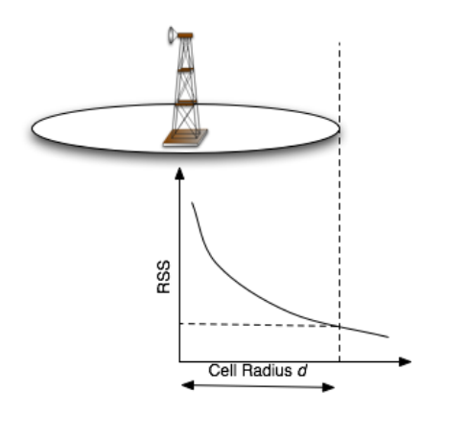
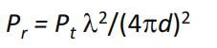
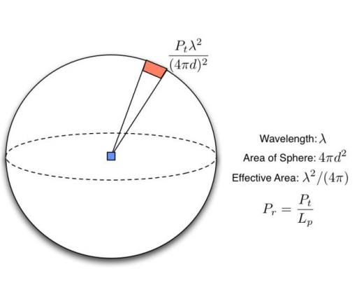
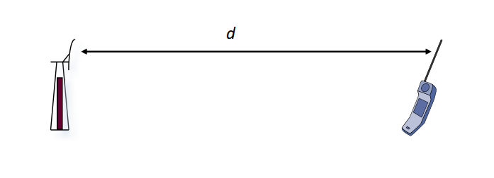
Radio waves propagation and attenuation The Free Space Loss

Slide 4
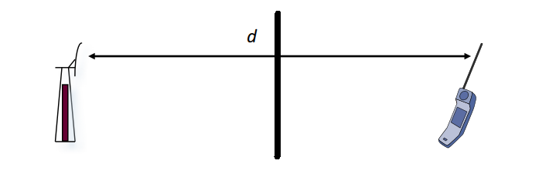
Radio waves propagation and attenuation The “not – Free” Space Loss?
Why is this even a problem?

Slide 5
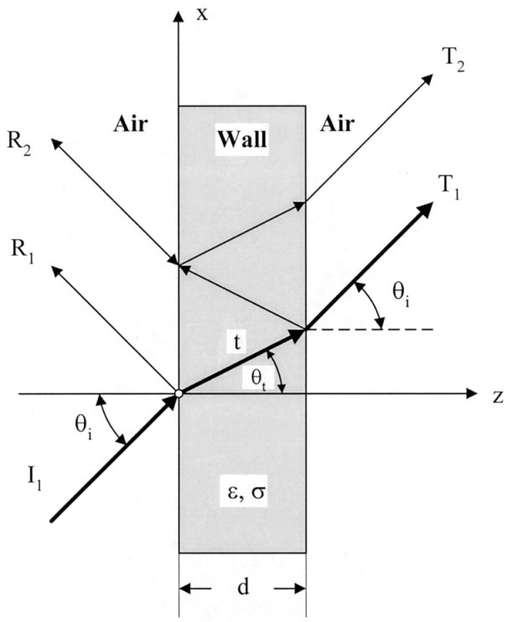
Radio waves propagation and attenuation The “not – Free” Space Loss?

Slide 6
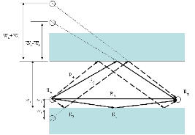
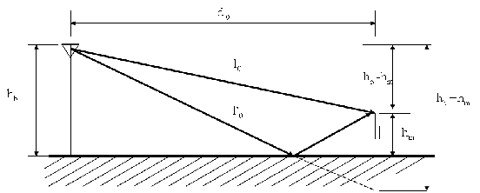
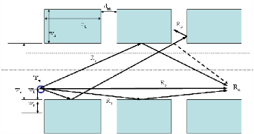
Radio waves propagation and attenuation The “not – Free” Space Loss?

Slide 7


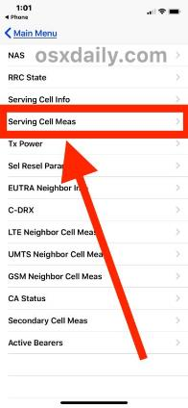
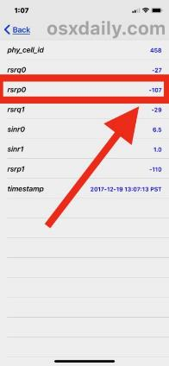
Radio waves propagation and attenuation The “not – Free” Space Loss?

Slide 8
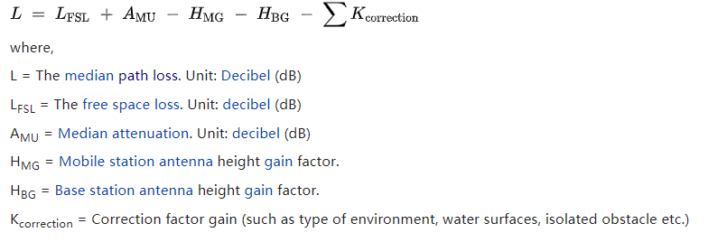
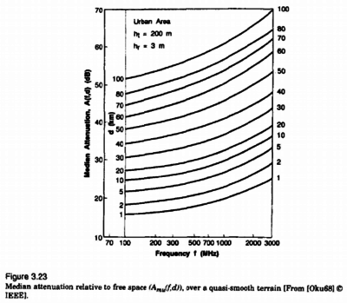
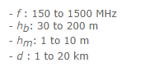
Radio waves propagation and attenuation Okumura Model
Limits:

Slide 9
Radio waves propagation and attenuation Propagation Modeling
A radio propagation model, also known as the radio wave propagation model or the radio frequency propagation model, is an empirical mathematical formulation for the characterization of radio wave propagation as a function of frequency, distance and other conditions.
A single model is usually developed to predict the behavior of propagation for all similar links under similar constraints. Created with the goal of formalizing the way radio waves are propagated from one place to another, such models typically predict the path loss along a link or the effective coverage area of a transmitter.

Slide 10
Radio waves propagation and attenuation Propagation Models
Models for free space attenuation
Free-space path loss
Dipole field strength in free space
Friis transmission equation
Models for outdoor attenuation
Terrain models
ITU terrain model
Egli model
Two-ray ground-reflection model
City models
Okumura model
Hata model for urban areas
Hata model for suburban areas
Hata model for open areas
COST Hata model
Models for indoor attenuation
ITU model for indoor attenuation
Log-distance path loss model
Notes:
References:
https://en.wikipedia.org/wiki/Okumura_model
http://morse.colorado.edu/~tlen5510/text/classwebch3.html
https://en.wikipedia.org/wiki/Radio_propagation_model
http://www.sis.pitt.edu/prashk/inf1072/Fall16/lec5.pdf
http://www.ajer.org/papers/v3(4)/ZO34335342.pdf

Slide 11
Part 2 Technology specifics and concept

Slide 12
The Longley-Rice model:
The Irregular Terrain Model (ITM), also known as the “Longley-Rice” model (named for Anita Longley & Phil Rice, 1968), is a model of radio propagation for frequencies between 20 MHz and 20 GHz. It is a general purpose model that can be applied to a large variety of engineering problems.

Slide 13
The Longley-Rice model:
The Longley-Rice model is a widely accepted model in the industry; the Federal Communications Commission (FCC) has also adopted this model as standard. It was initially developed for the frequency planning needs of TV broadcasting in the US.

Slide 14
The Longley-Rice model:
Two parts:
A model for predictions over an area.
A model for point-to- point link predictions.
Four variations:
Single-signal mode
Single-antenna mode
Mobile mode
Broadcast mode
Notes:
In the early programs of the longley-rice model, all calculations of point-to-point predictions were based on a single antenna pattern, where the antenna position was constant.
Later, due to the increased demand for calculation accuracy, other models were introduced.
In various modes of change, the main changes are three parameters: time, location, and scenario, or a three- dimensional variable.

Slide 15
Advantages
The significant advantages of the Longley-Rice propagation model is its capability to set different parameters that have an effect on the way in which computations are done; thus the model can be customized for a wide range of applications.

Slide 16
The Longley-Rice model:

Slide 17
General Input into the model:
Frequency
The nominal frequency range is 20 MHz to 20 GHz.
Effective Radiated Power(ERP)
ERP is entered as per the units set by the user (W, mW, kW, dBW, dBm, dBk)
Height
The height of antenna above the ground has to be entered as per units set by user (meters or feet); the effective height for calculations will be estimated by the program itself.

Slide 18
General Input into the model:
Polarization
Vertical or horizontal polarization.
Surface Refractivity
The refractivity of the atmosphere, measured in N-Units (parts per million), which typically ranges from 250 to 400 N-units
Permittivity
The dielectric constant of the ground.
Conductivity:
Soil conductivity of the ground.

Slide 19
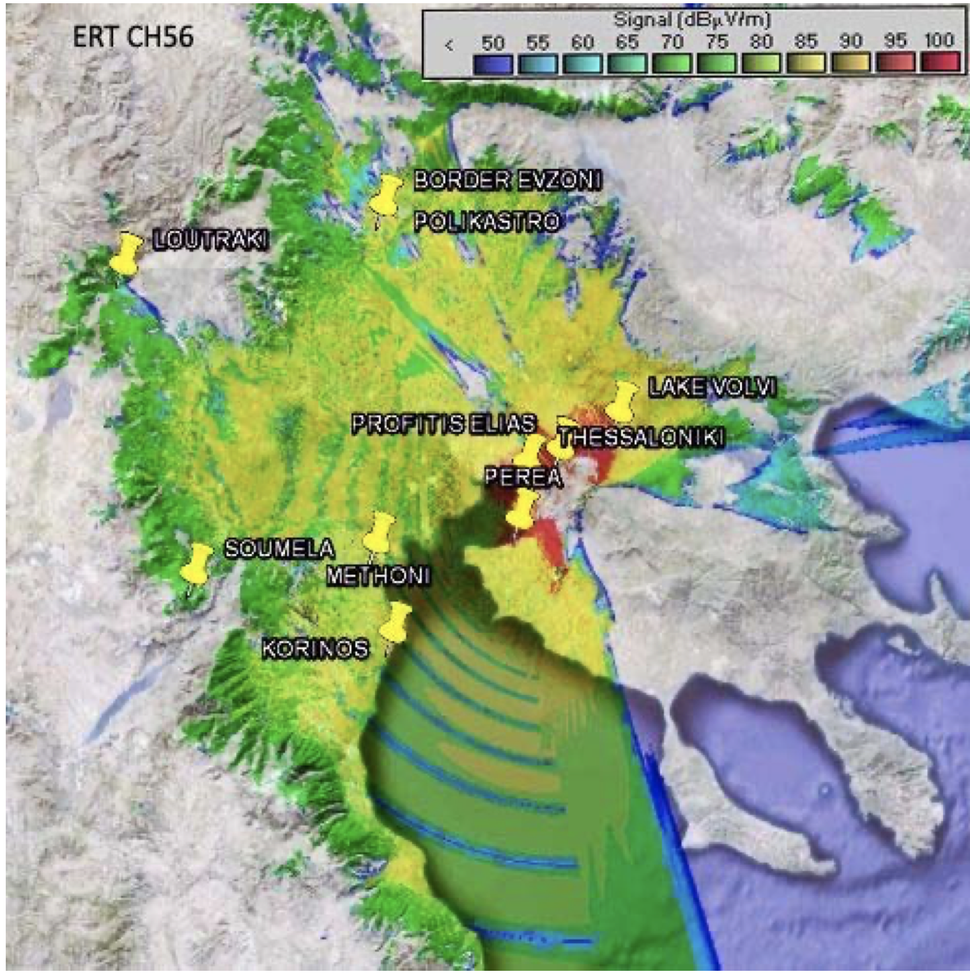
Coverage map produced by ITM

Slide 20
Part 3 Current design/Algorithm

Slide 21
The ITM was designed as a simplification of the TN 101 and specifically for a compiled program such as Fortran 66 and C++
The ITM predicts the reference attenuation Aref, which is added to free space attenuation (FSL) of a radio signal based on distance, environmental and geographical characteristics.
Its structure and algorithms are based over two hundred documents which established the foundations of radio link and coverture modeling, valid up to the present.

Slide 22
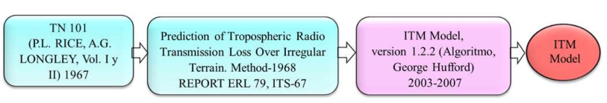
Evolution of the ITM model
A byproduct of Technical Note 101, is cornerstone foundation of 1968 ITM

Slide 23
Main characteristics of the ITM model.
Characteristics | Description
Model | Deterministic
Based on | Electromagnetic theory
Modes | Point-to-point and point to zone (Area)
Zones | FSL, LOS, Diffraction and Scatter
Statistics | Variabilities: time, locations and situations

Slide 24
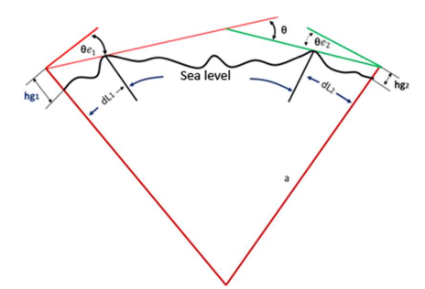
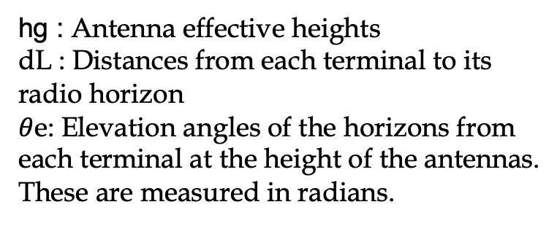
ITM model structure
It starts assuming a hypothetical reference profile divided in four zones
hg : Antenna effective heights
dL : Distances from each terminal to its radio horizon
$θ$e: Elevation angles of the horizons from each terminal at the height of the antennas. These are measured in radians.
antenna heights, reference distances and elevations angles

Slide 25
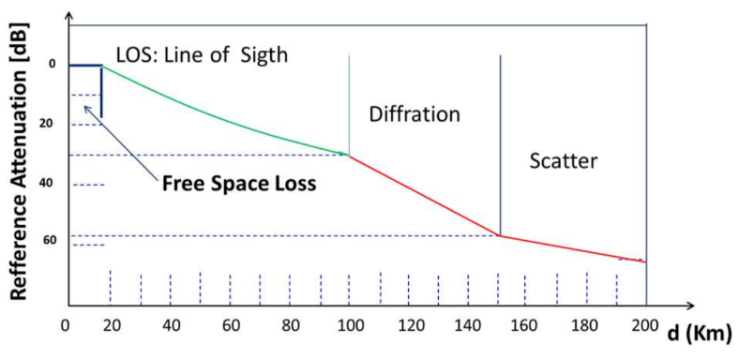
ITM model Zones and additional attenuation to FSL

Slide 26
ITM model Zones and additional attenuation to FSL
Zone | Description
FS | Reference attenuation is zero, received level is equal to FSL
LOS | Reference attenuation includes the 2-Ray model, atmospheric absorption, clutter and diffraction extrapolation from the diffraction zone weighted by a factor function of Δh
Diffraction | The knife edge and smooth earth reference attenuation weighted by a factor function of Δh
Scatter | Troposcatter reference attenuation, starting from the interception of diffraction and scatter, linear reference attenuations. No weighted factor included

Slide 27
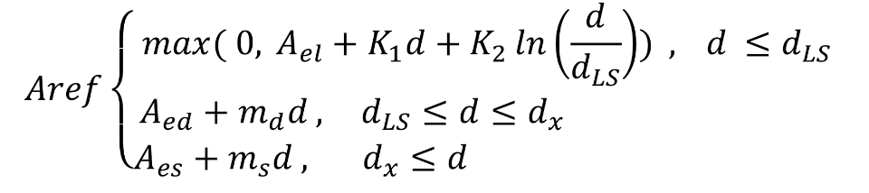
Three A_{ref} main equations(GeorgeHufford’ Algorithm)
The 1st equation defines the first two zones: FSL and LOS. In FSL zone, Aref = 0
Diffraction zone defines a dB straight-line, which will be extended to the LOS zone
The 3rd equation defines another straight line based on the reference attenuation by Scatter

Slide 28
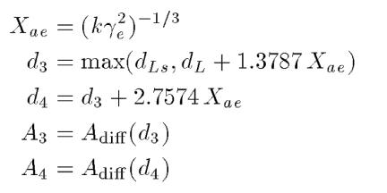
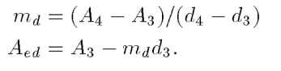
Coefficients of ITM algorithms
The coefficients
A_{el},K₁,K₂,A_{ed},m_{d},A_{es},m_{s},and the distance d_{x}
are calculated using the algorithms below

Slide 29
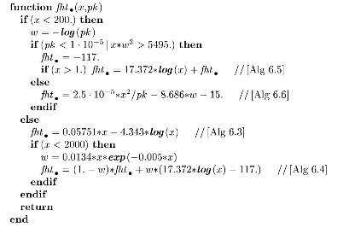
The latest update of ITM model
It is a 33 page long document
It contains both the source code and a rather extensive documentation
Updated 5 Aug 2002 to fix missing functions
Institute for telecommunication sciences
https://www.its.bldrdoc.gov/resources/radio-propagation-software/itm/itm.aspx

Slide 30
Part 4 Market and regulation implications and complications

Slide 31
From contour method to Longley-Rice
Contour method
Work well for many years.
Calculate part of the terrain to give the prediction of attenuation.
Due to the above reason, it doesn’t work that accurate.

Slide 32
From contour method to Longley-Rice
Longley-Rice
First developed rapidly due to the demand of television frequency planning.
Compare to contour method, it calculates more to get the prediction of attenuation, including more parts of the terrain, atmosphere and ground cover etc.
Because this model must calculate many factors, it consumes lots of computer power. So, Longley-Rice model was restricted to use for some years for economic reasons.

Slide 33
Longley-Rice model’s market and application
Television frequency planning in the 1960s
National Oceanic and Atmospheric Administration developed weather forecasting satellite system with Longley-Rice model

Slide 34
Longley-Rice model’s market and application
Radar system, mobile phone system, international shortwave broadcasters and radio navigation could be improved
Traffic control in air, navigation system in air and marine communication also could be improved

Slide 35
Regulation of Longley-Rice model
Before 2010, the use of Longley-Rice model was restricted to the situation that the delta-h value(this value is a measure of terrain roughness) along paths was less than 20m or greater than 100m. There is also a requirement of a 10% variance of the prediction between Longley-Rice model and standard method.
At 2010, a decision called Skytower was published by FCC. In this decision, the requirement of delta-h value was deleted. But another requirement was added. The Longley-Rice model can only be used when the Longley-Rice field strength is 70dBu.

Slide 36
Regulation of Longley-Rice model
According to the Federal Communication Commission, the use of Longley-Rice model for FM stations is restricted to the city of license and the use of finding main studio location.
But on the other hand, the use of this model for Television coverage studies is not restricted.
In addition, Longley-Rice model can take the receive antenna height and gain into consideration to get a better result. But submissions to the Federal Communication Commission using Longley-Rice are still required to be based on a dipole antenna at the standard height of 30m.

Slide 37
Part 5 Opinion and idea

Slide 38
The legacy of Longley-Rice Model
A good deal of information was obtained regarding radio propagation through the turbulent atmosphere over irregular terrain prior to the invention of Longley-Rice model
A good deal of data had also been accumulated from high-powered broadcast transmitting antennas to rather well-sited receivers

Slide 39
The legacy of Longley-Rice Model
The ITS irregular terrain model is combination of an empirical model with measured data, which means it was well suited for computer use. And the benchmark was determined by the U.S. Department of Commerce in 1982.
As a result, the modern computer language and algorithms became a great tool to implement this model.

Slide 40
The legacy of Longley-Rice Model
The result is an accurate representation of how a propagated signal behaves in each environment since the Longley-Rice model looks at all the terrain along a given path length.
The Longley-Rice model also has capability to set different parameters that influences the way in which computations are done, thus the model can be customized for a wide range of applications.

Slide 41
The limitation of ITM model
Concepts
Point-to-point model:
A point-to-point model demands detailed information
about the propagation path.
A point-to-point model should be able to predict the values of path loss, service range and how equipment will behave in various situations.

Slide 42
The limitation of ITM model
Concepts
Area prediction:
An area prediction model do not require that there be a particular path.
The usual problem is to define the communications reliability of a service or to estimate the received signal level

Slide 43
The limitation of ITM model
The ITM point-to-point model did poorly on point-to-point mode.

Slide 44
The limitation of ITM model
Main reasons:
The core software works best with terrain databases with no more than 30 arc-second detail. Whereas most users today use more recent and more detailed data bases.
Being a general-purpose model, the ITM does not implement sufficient landmark features.
The ITM core has several math errors, mainly are outdated approximations

Slide 45
The limitation of ITM model
Therefore, the ITM cannot provide true point-to-point, terrain-point-specific answers, and it can only provide average outcomes.

Slide 46
Improved models
For digital television and FM broadcasting, more accurate point-to-point prediction tools need to be deployed.
ITWOM (Irregular Terrain with Obstructions Model):
This model is specific and accurate enough to be used for the interference studies for which it was developed, has been in continuous development since 2005.

Slide 47
Improved models
The Linear Least-Squares algorithm in subroutine (a set of computer instructions for a small task) zlsql is corrected to fix a problem with the calculation of the terrain irregularity parameter delta-h.
The dlthx subroutine is updated in two places, to allow calculations for databases that have intervals shorter than 30-arcsecond
The use of effective heights for the transmitter and receiver antenna heights is replaced by actual heights, taken from the terrain database

Slide 48
Improved models
A comparison of Longley-Rice and ITWOM propagation models for DTV and FM Broadcasting was made by tylianos Kasampalis, Pavlos I. Lazaridis et al, 2013
It used the 3-arc-second Satellite Radar Terrain Mission (SRTM) maps
The simulation program is SPLAT! (an RF Signal Propagation, Loss, And Terrain analysis tool)

Slide 49
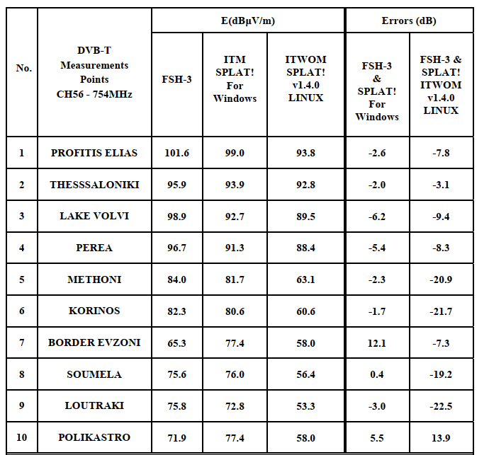
Improved models
Fig1, This is a point-to-point analysis for public Greek Digital TV
FSH-3 is the measurement

Slide 50
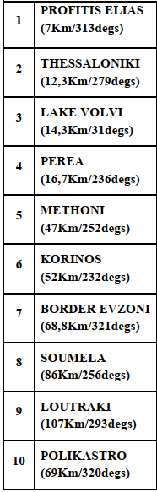
Improved models
The simulations and measurements results in point-to-point path analysis with ITWOM shows The ITWOM has a better accuracy for distances < 20Km, but very big differences for larger distances > 40Km.

Slide 51
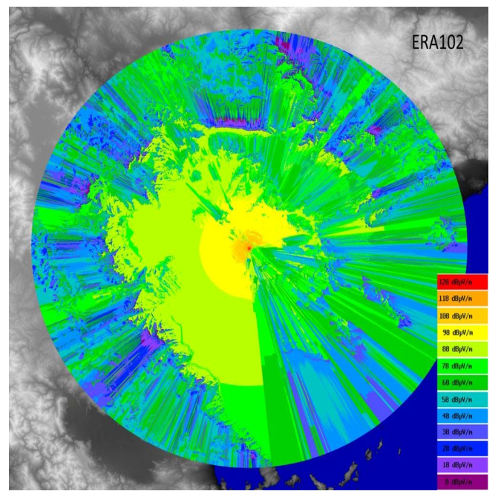
Improved models
Fig 2, the overage map produced by SPLAT!-ITWOM (Linux), for FM radio station "ERA-102".

